Slide 1
ROTORDYNAMIC ANALYSIS OF THEORETICAL MODELS AND
EXPERIMENTAL SYSTEMS
A Thesis presented to
the Faculty of California Polytechnic State University, San Luis Obispo
In Partial Fulfillment
of the Requirements for the Degree
Master of Science in Mechanical Engineering
by
Cameron Naugle
April 2018

Slide 2
Processing and analysis of vibration signals
Development of a finite element model for rotordynamics
Frequency domain processing of rotordynamic models
Comparison of experimental and model analyses

Slide 3
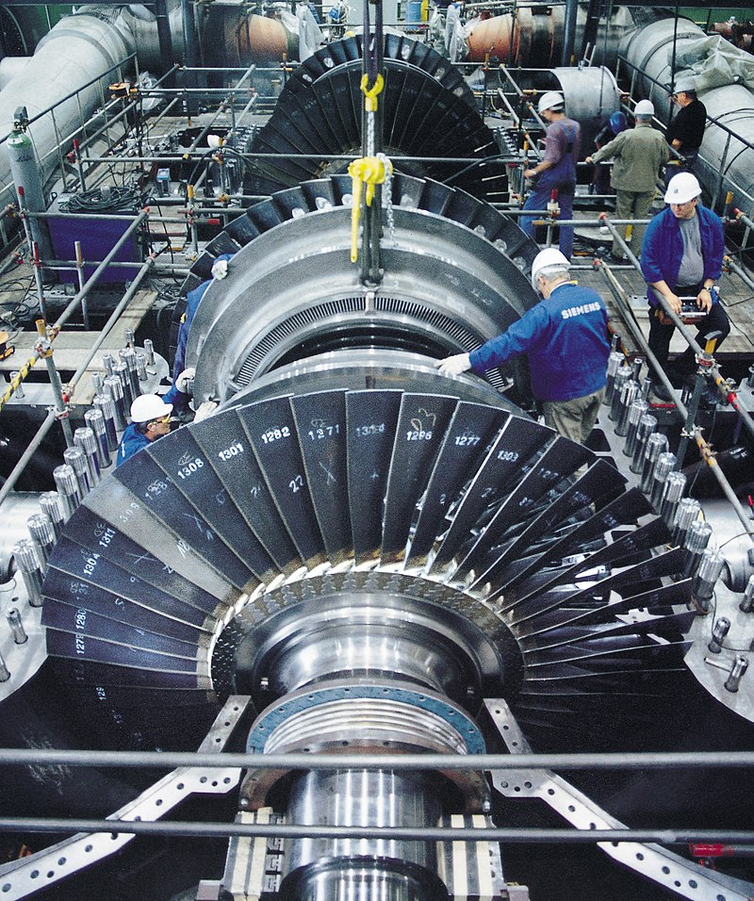

Slide 4
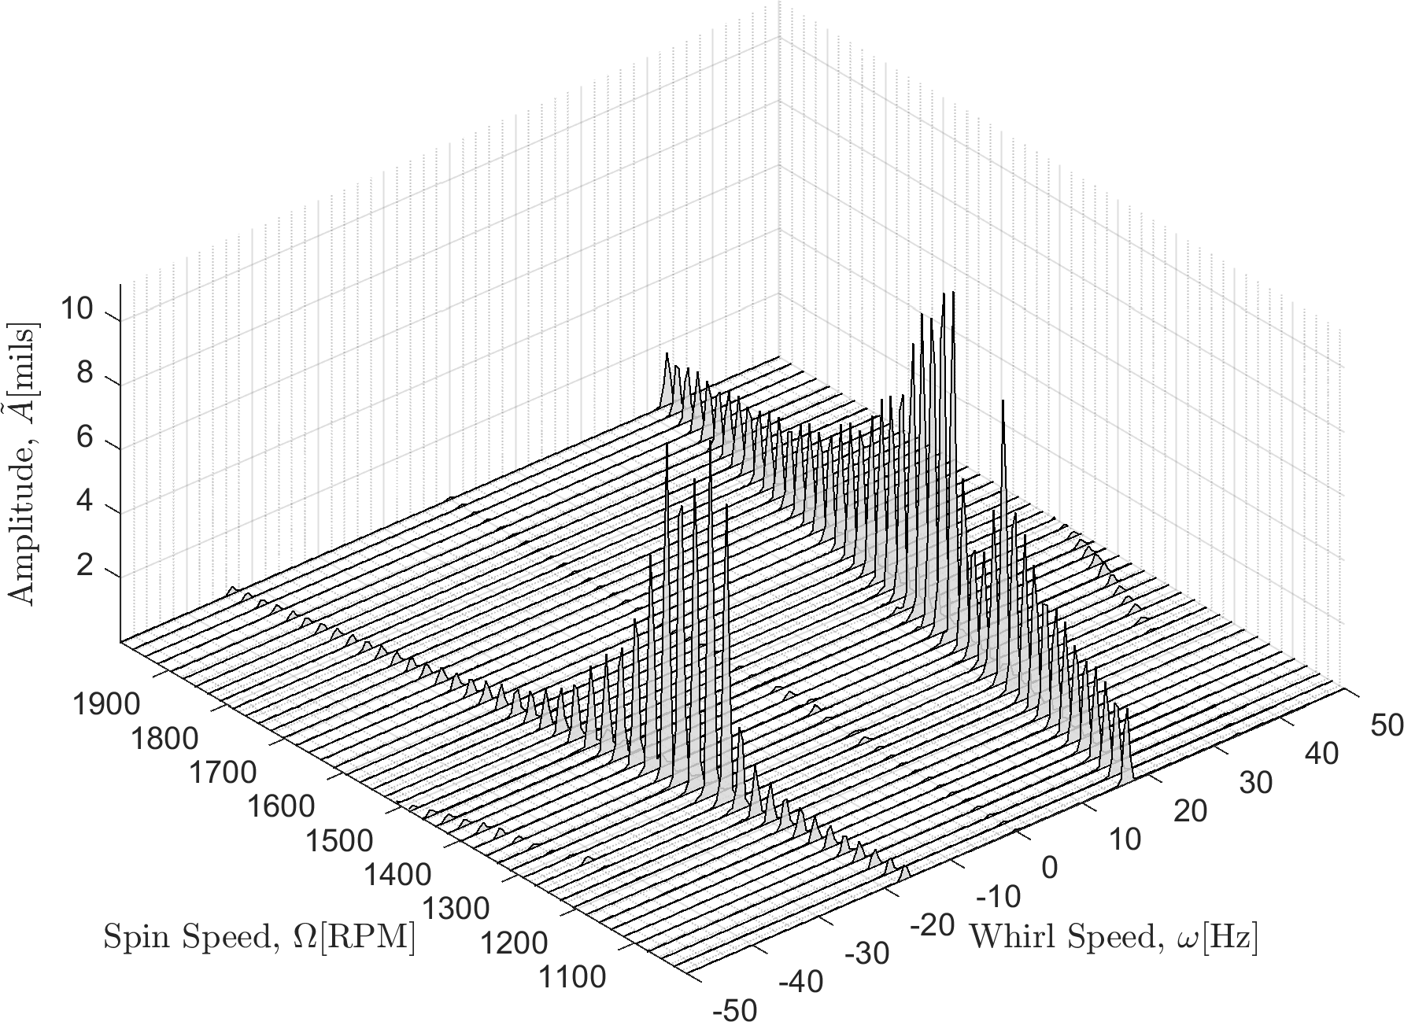
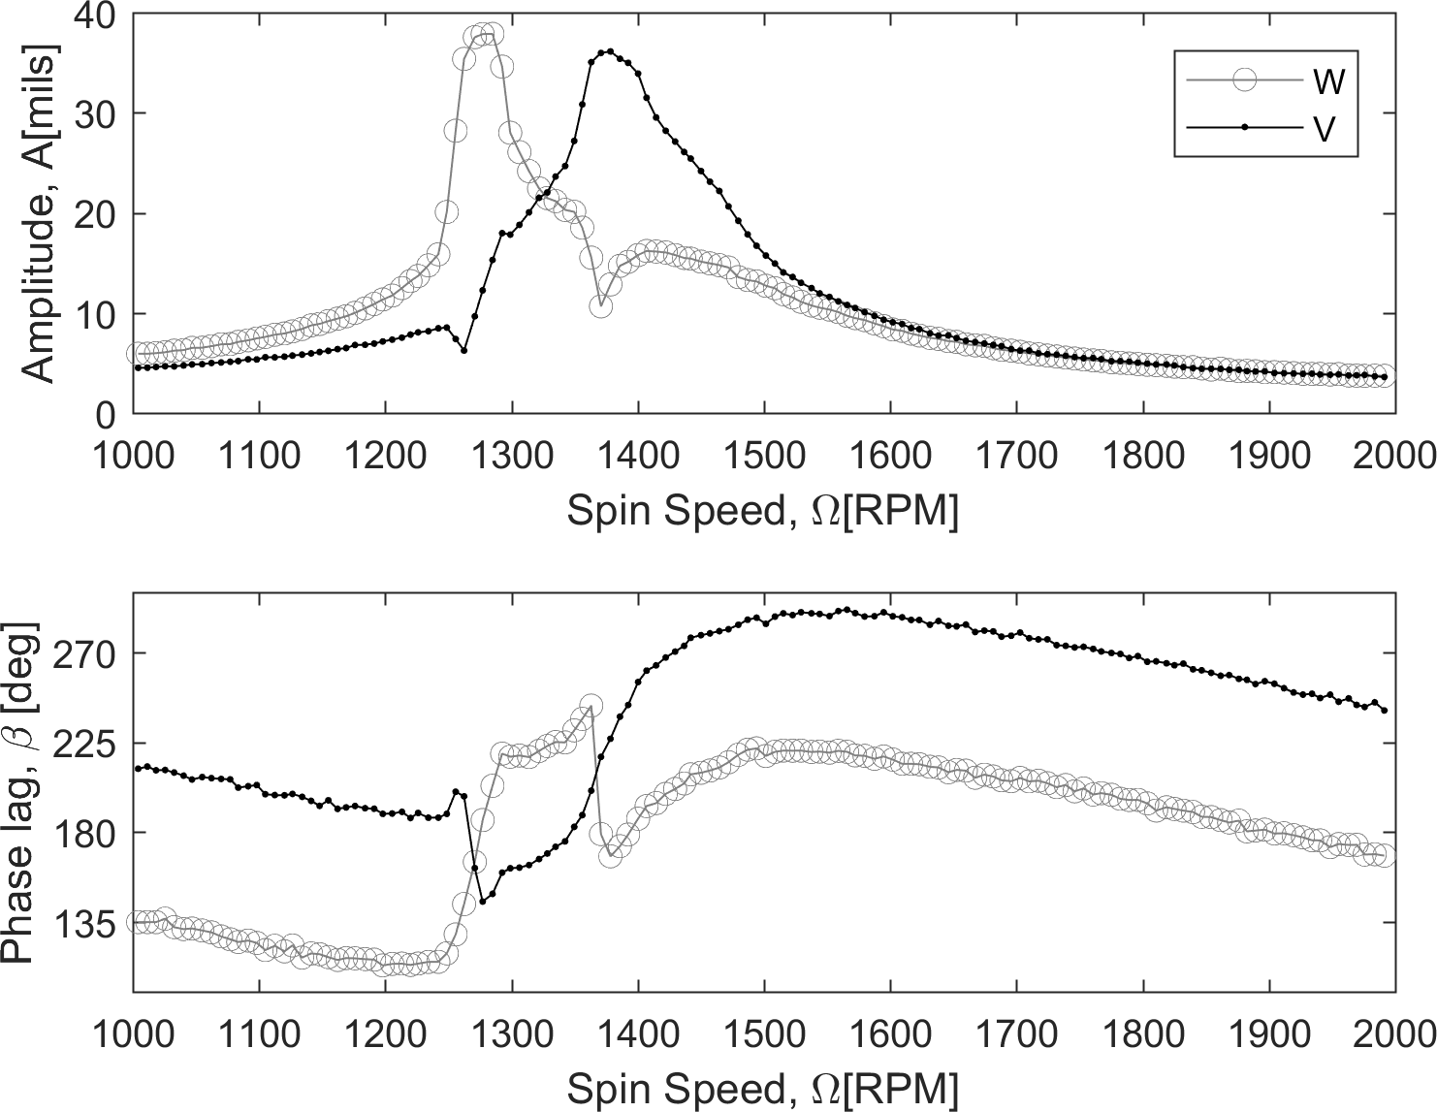
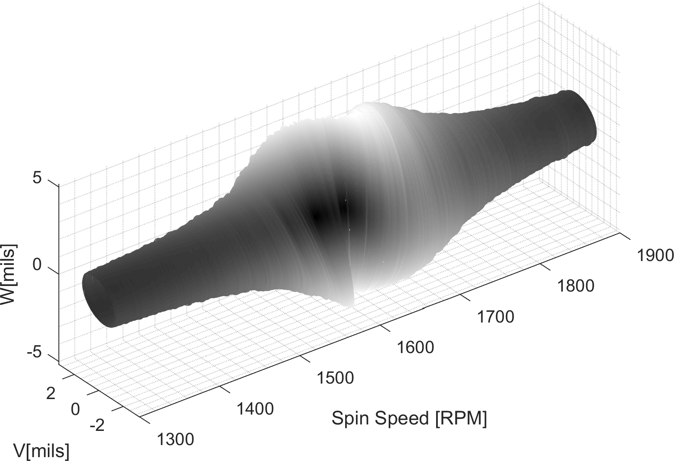
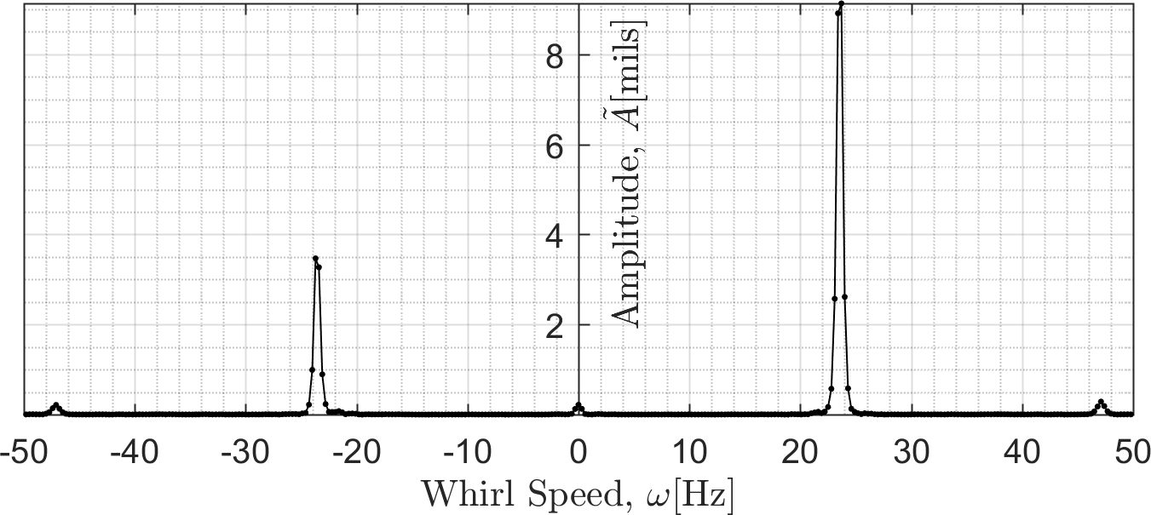

Slide 5
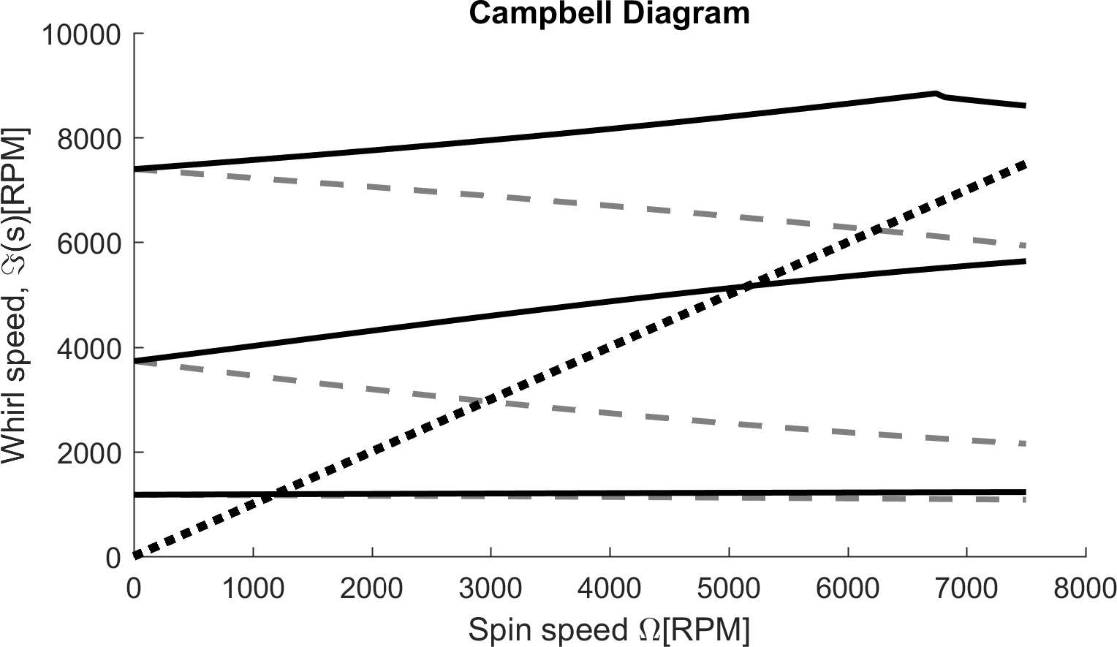
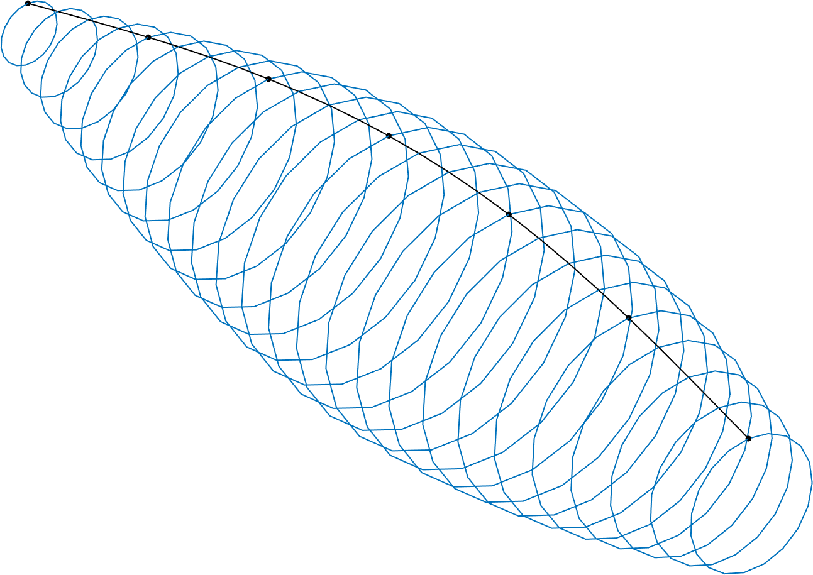
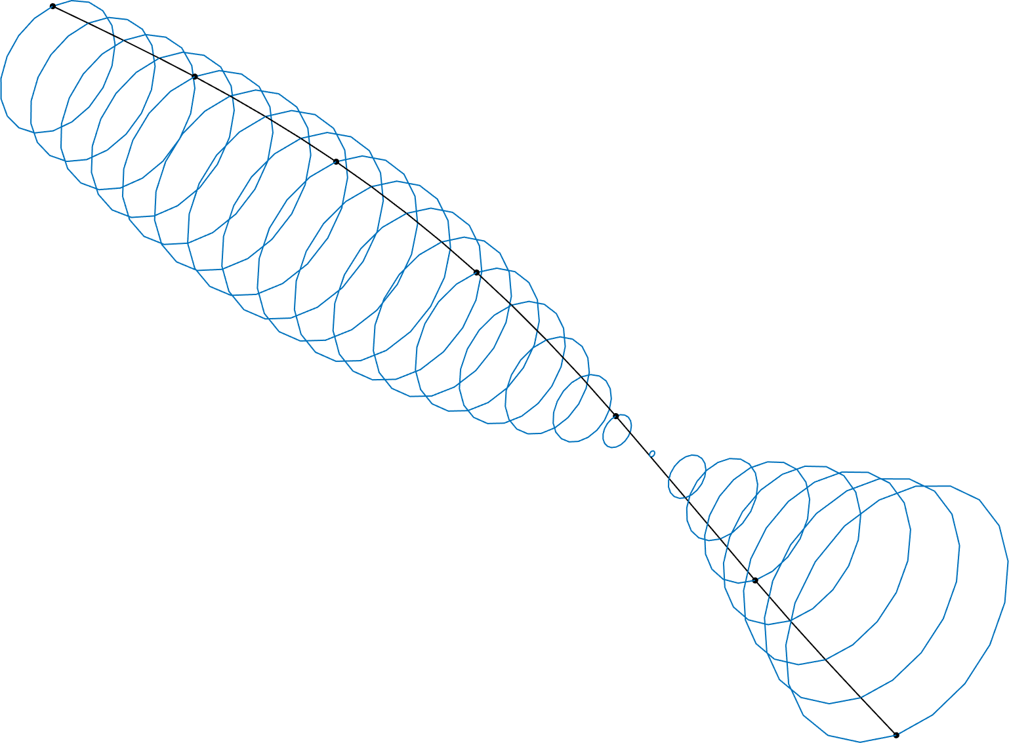
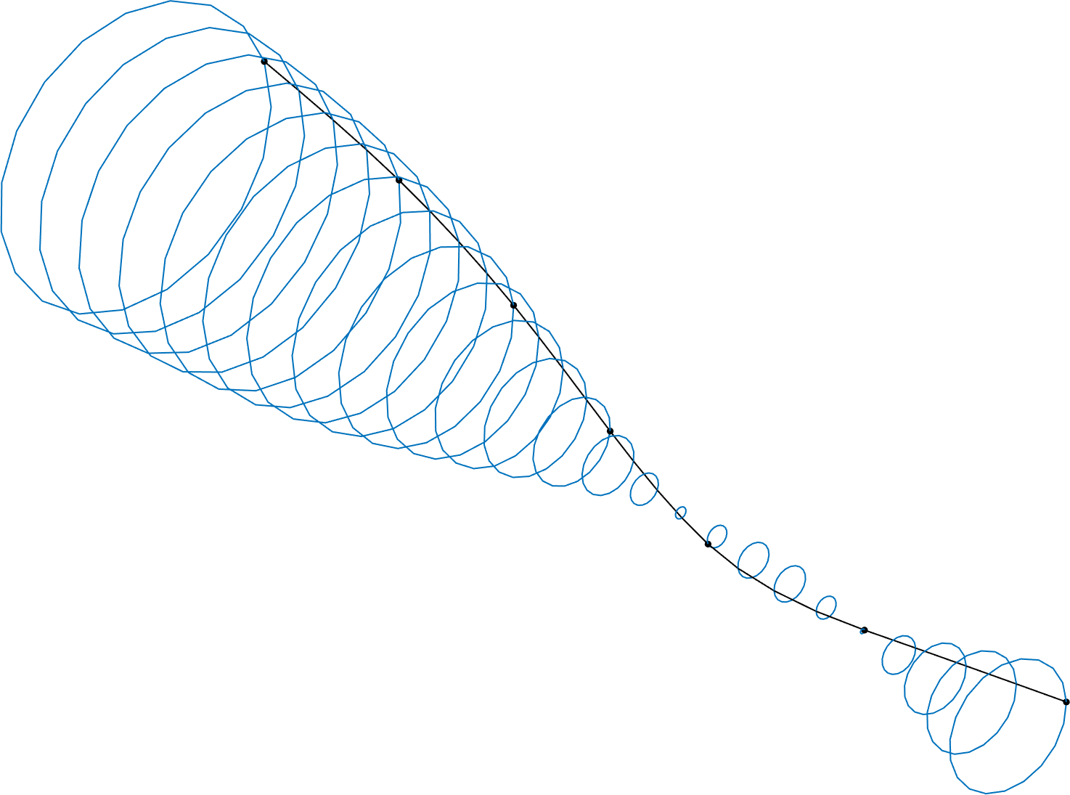
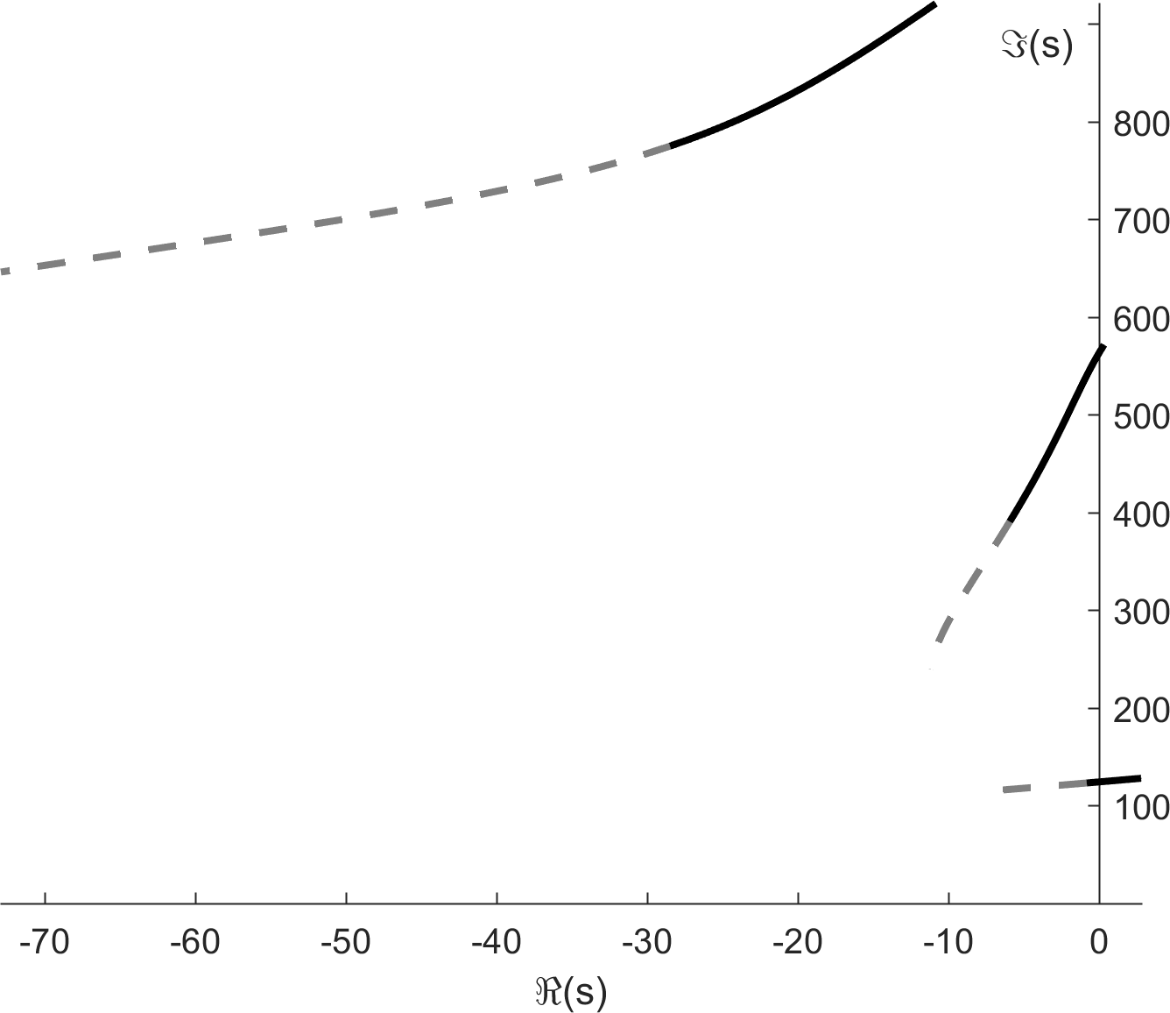
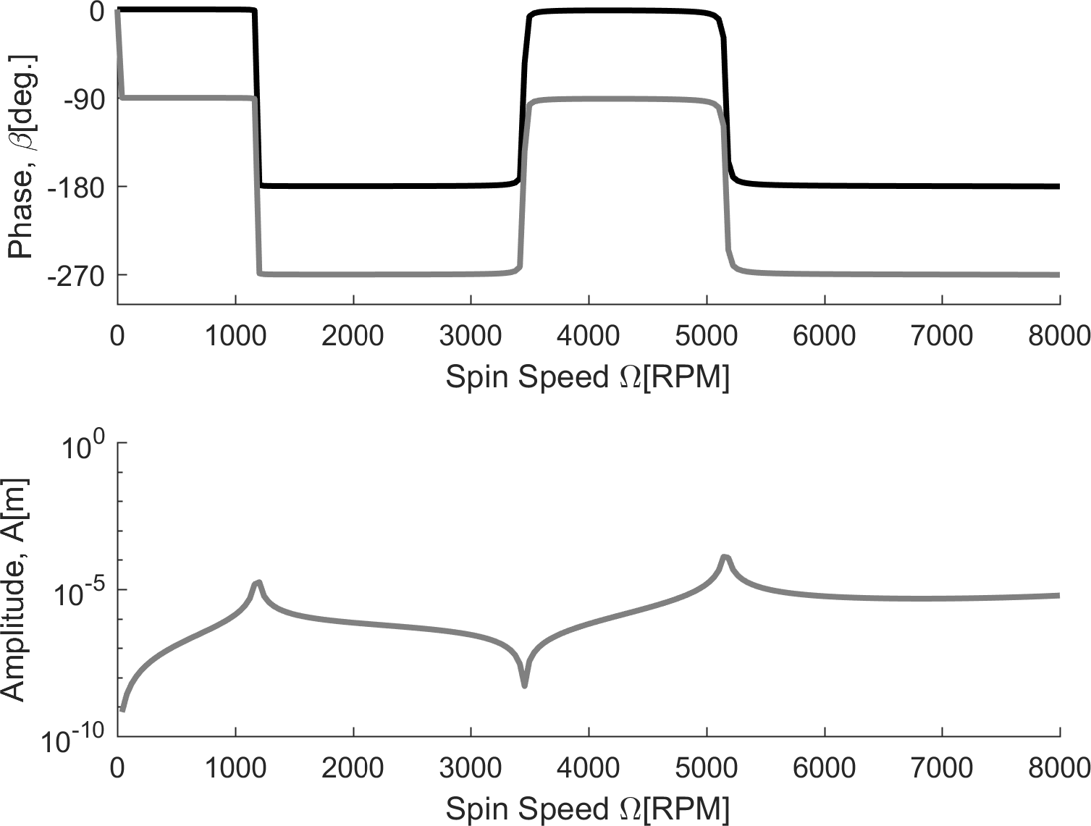

Slide 6
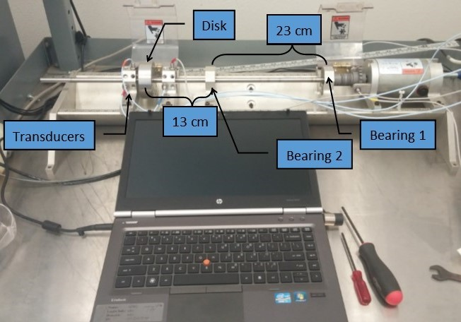
Processing and analysis of vibration signals

Slide 7
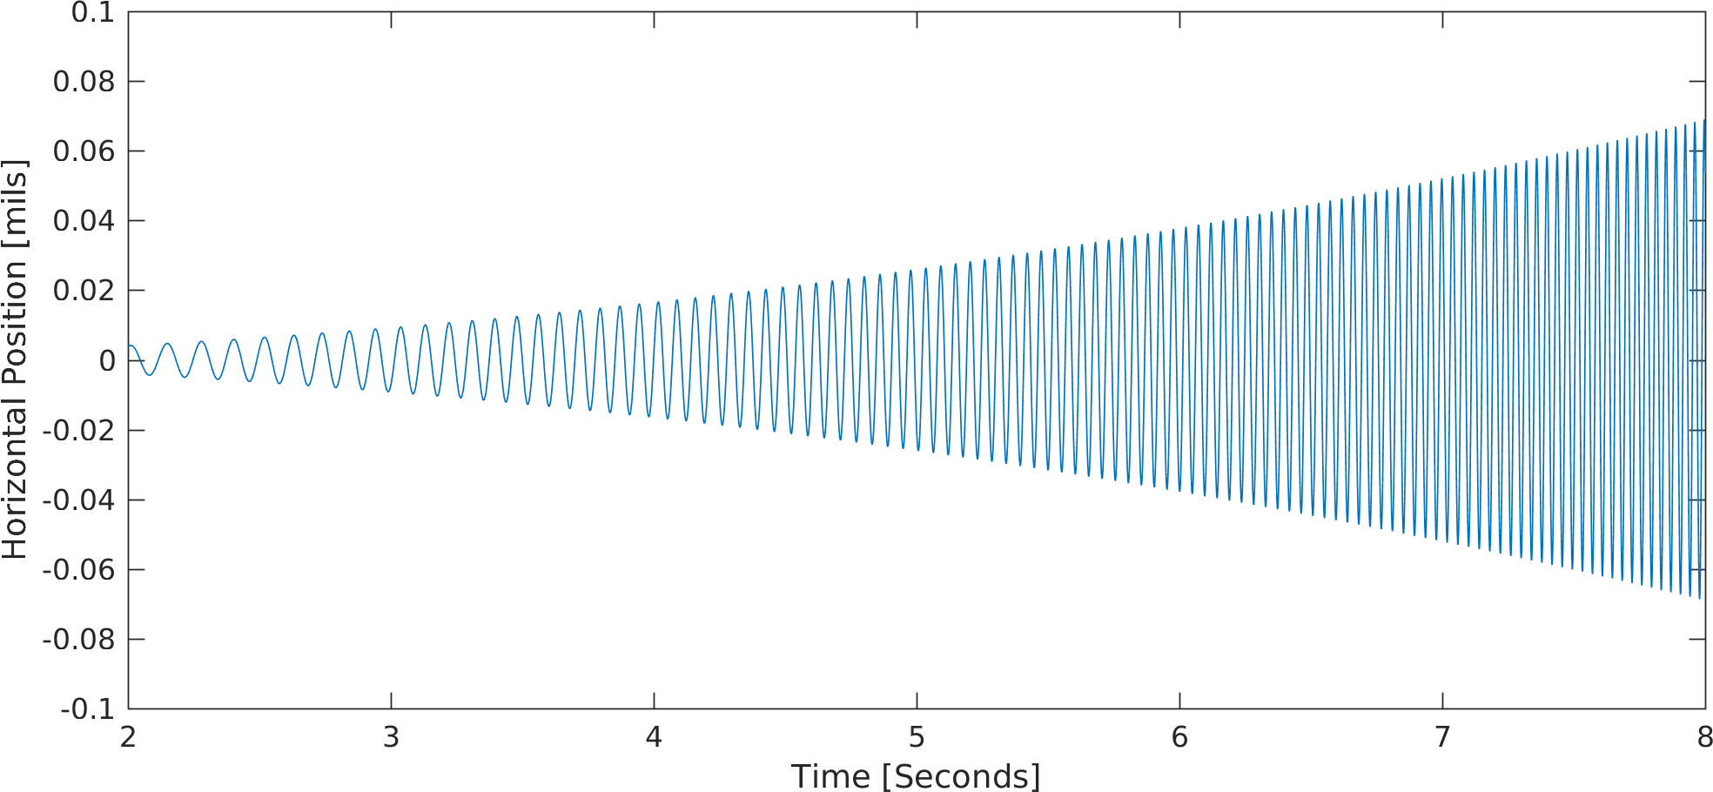
Processing and analysis of vibration signals

Slide 8
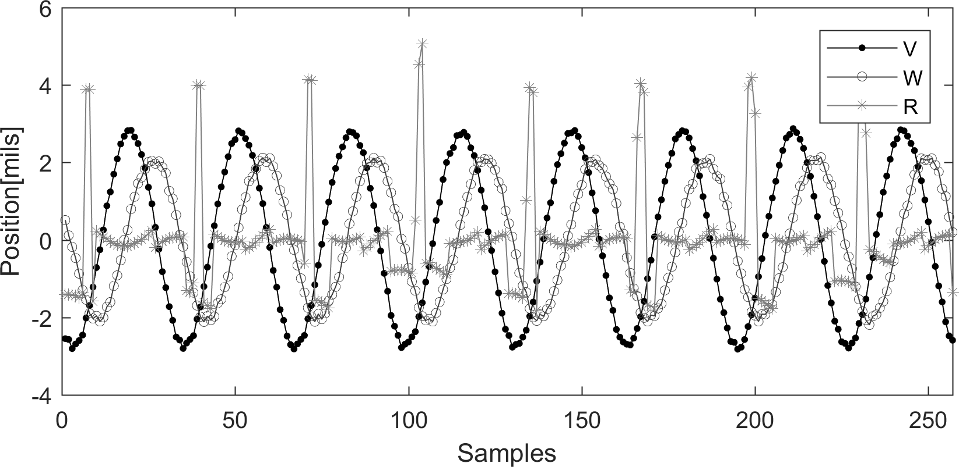
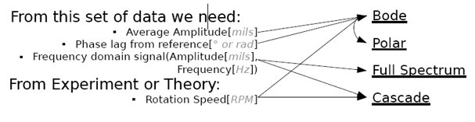
Processing and analysis of vibration signals

Slide 9
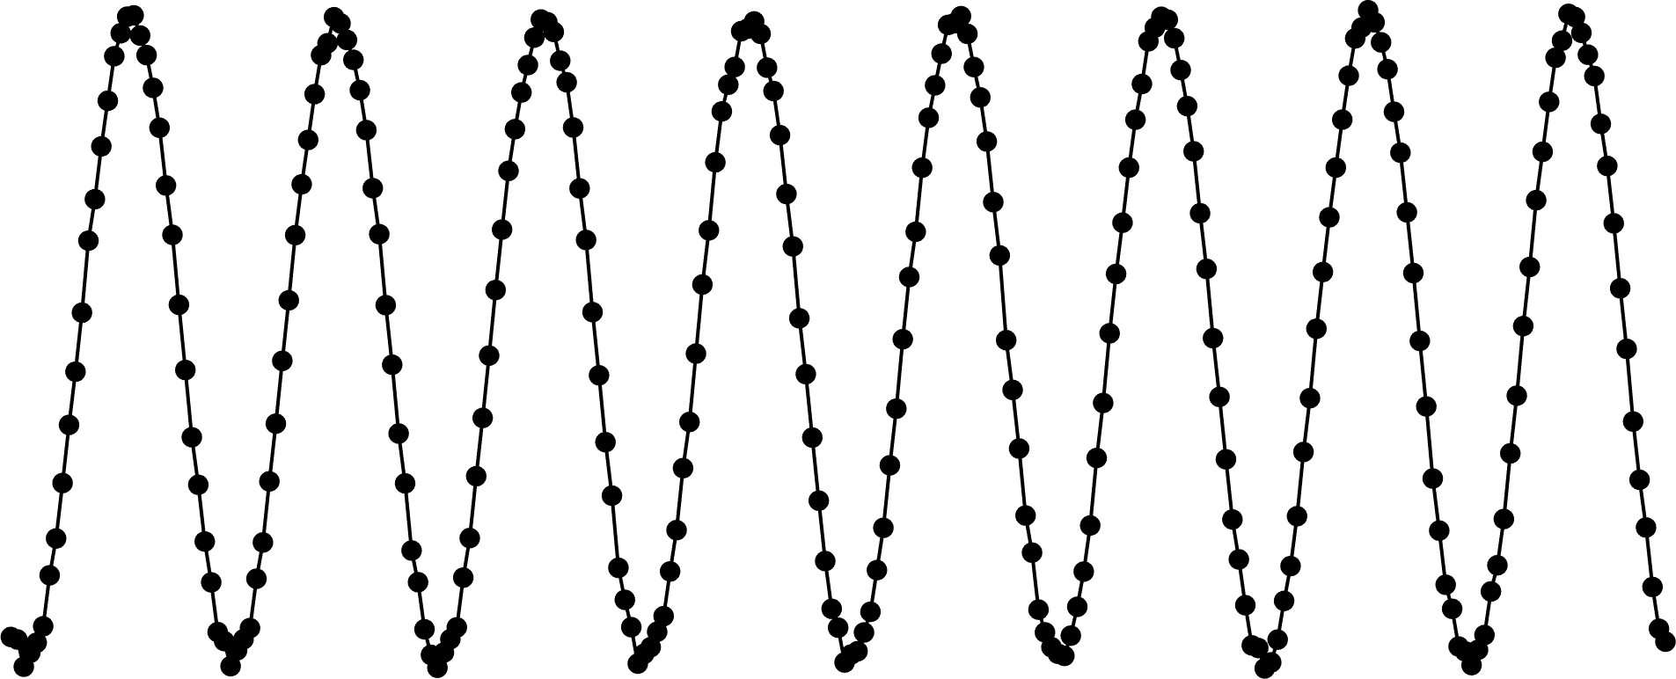
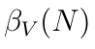
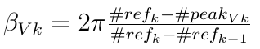
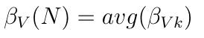
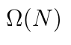
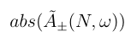
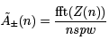
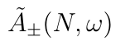
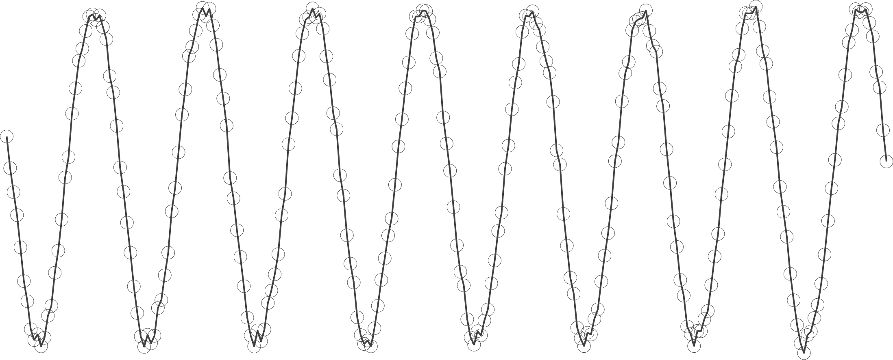
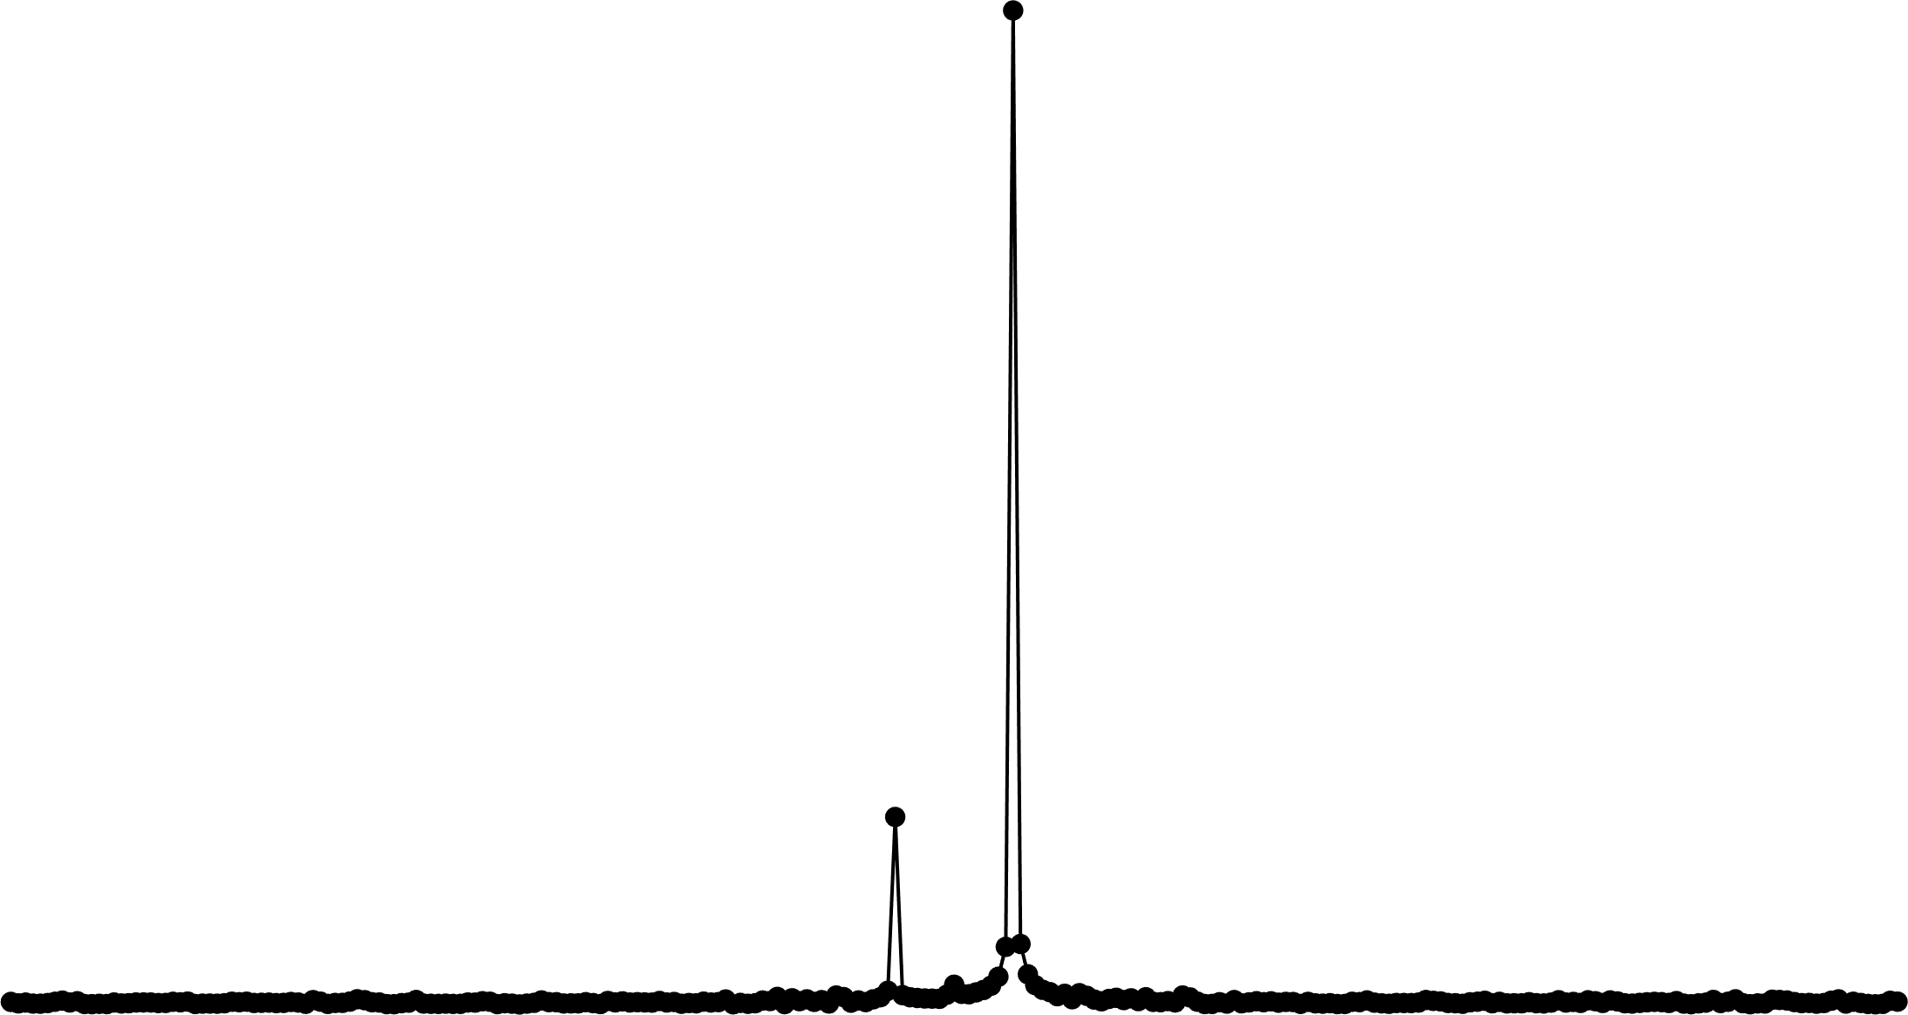
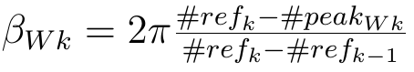
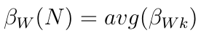
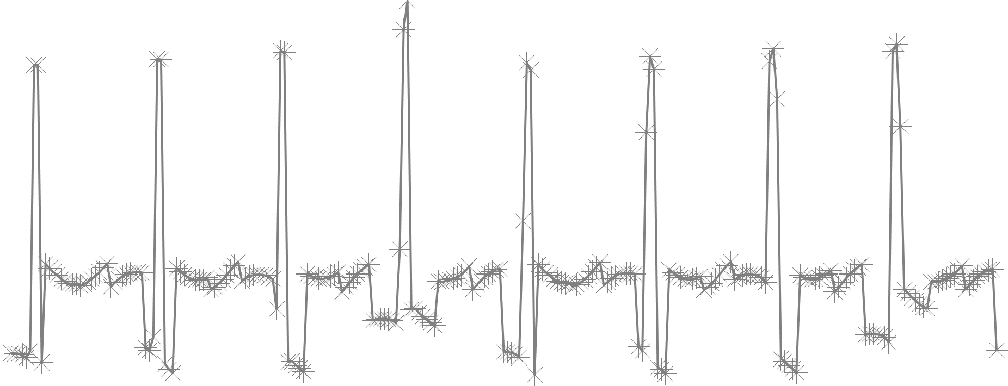
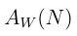
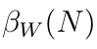
Processing and analysis of vibration signals
Analysis Variables
Signal Processing
V
W
R

Slide 10
Processing and analysis of vibration signals
Bode Diagram

Slide 11
Processing and analysis of vibration signals
Cascade

Slide 12
Processing and analysis of vibration signals
Spectrum

Slide 13
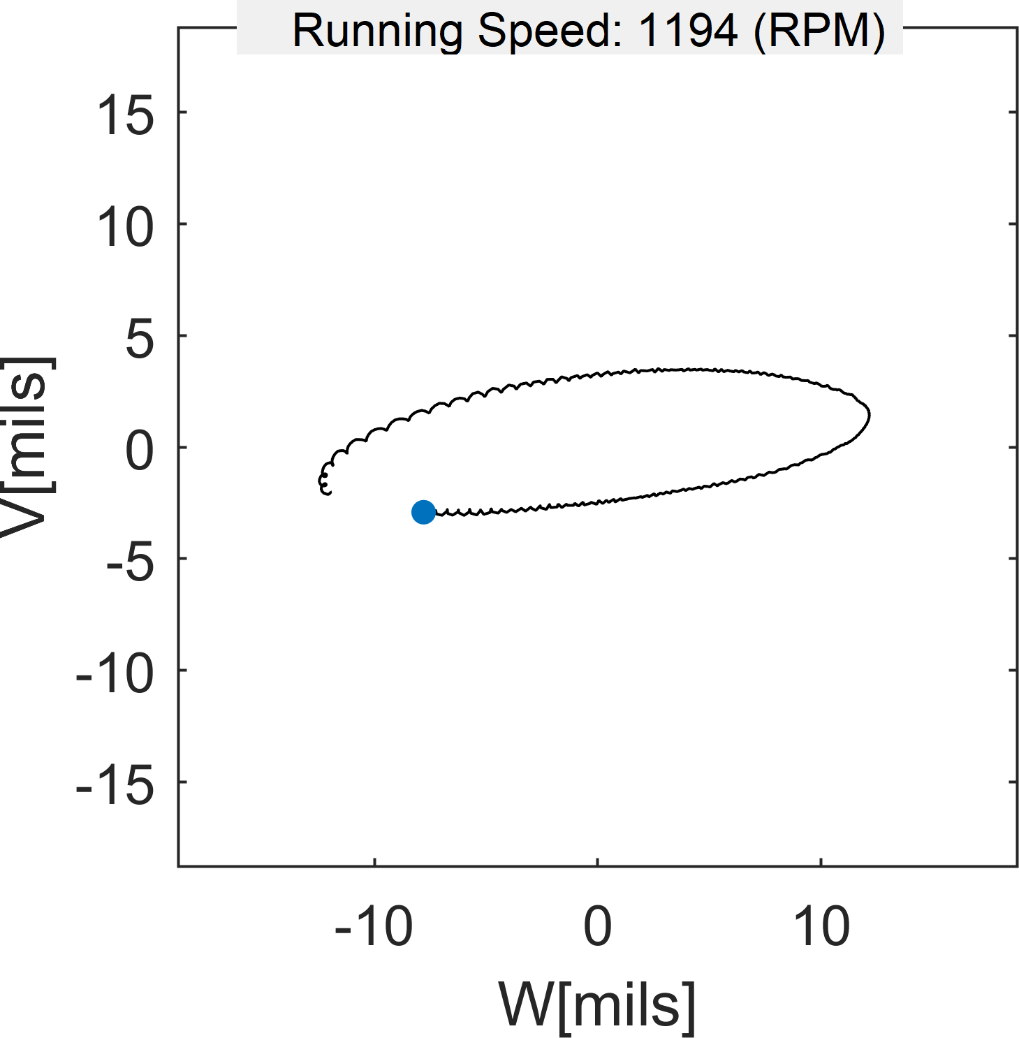
Processing and analysis of vibration signals
Orbit
V
W

Slide 14
Processing and analysis of vibration signals
3D Orbit
V
W

Slide 15
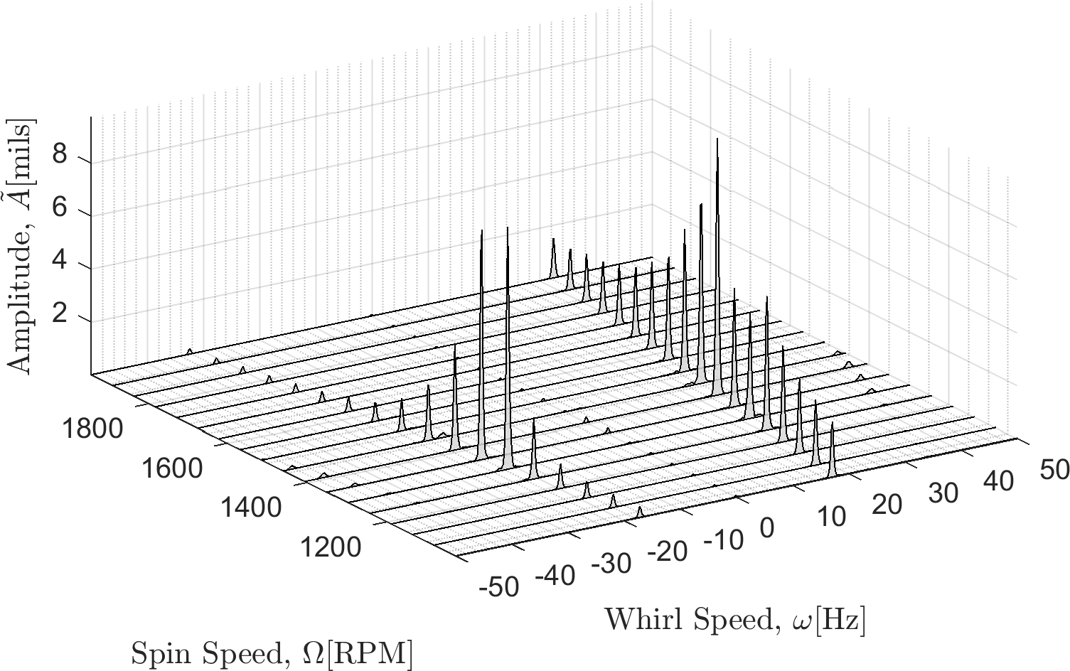
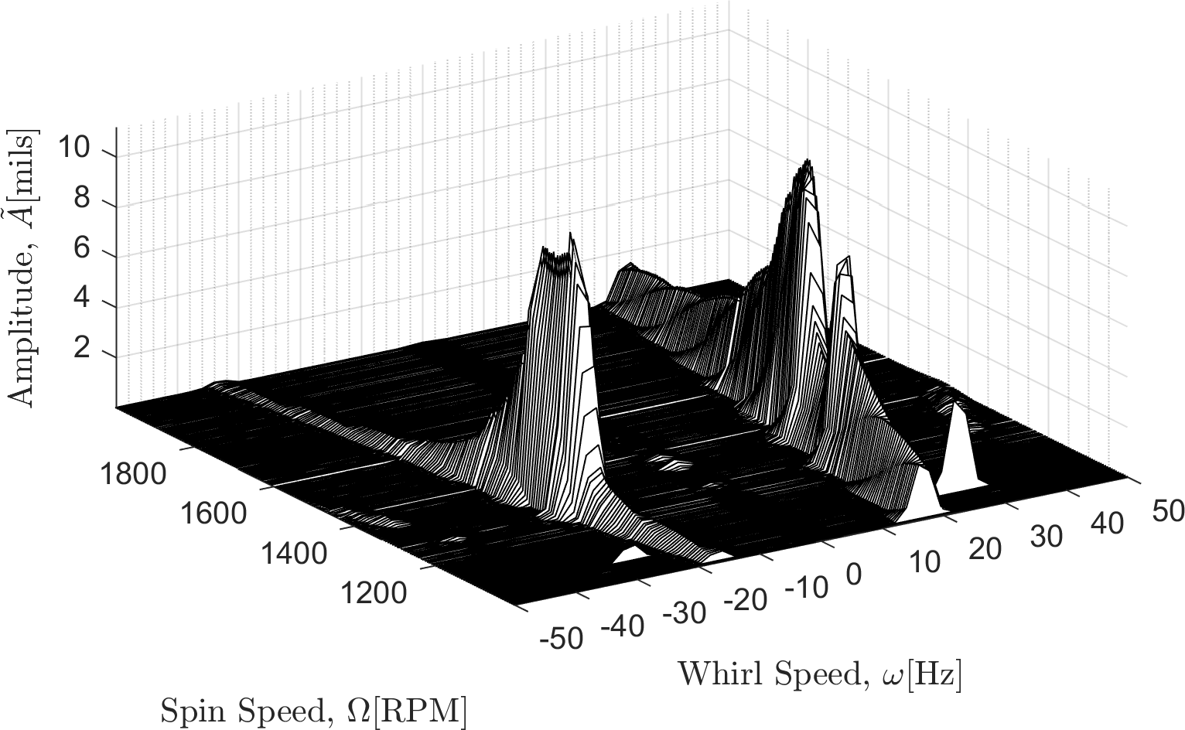
Processing and analysis of vibration signals

Slide 16
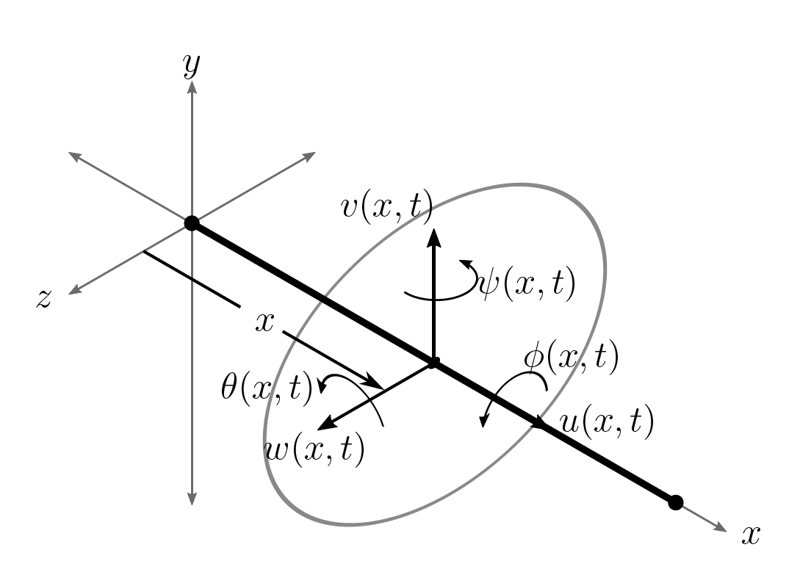
Development of a finite element model for rotordynamics

Slide 17
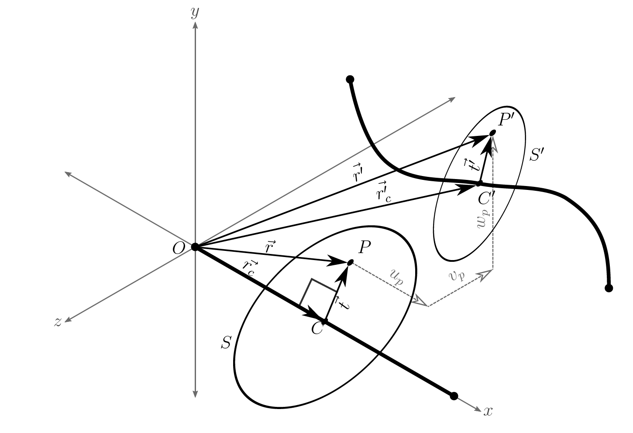
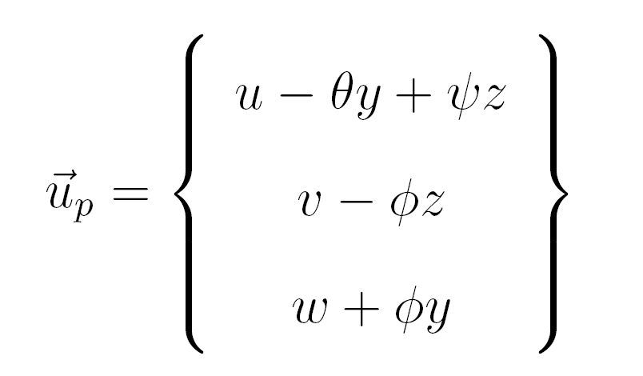
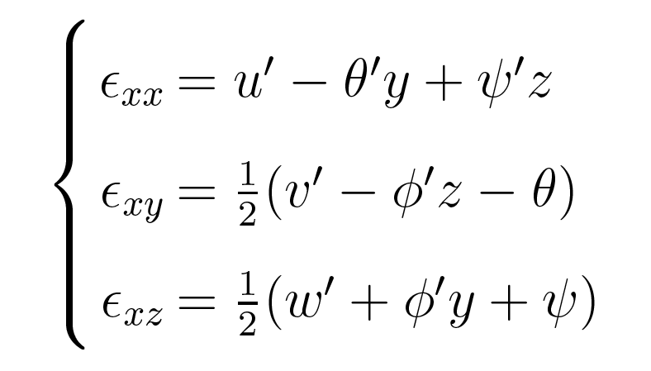
Development of a finite element model for rotordynamics

Slide 18
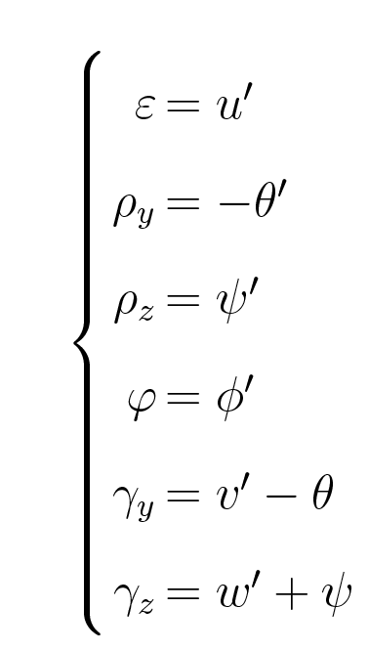
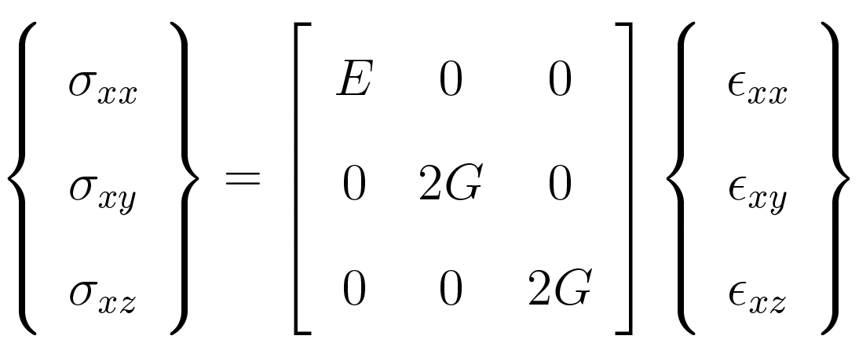
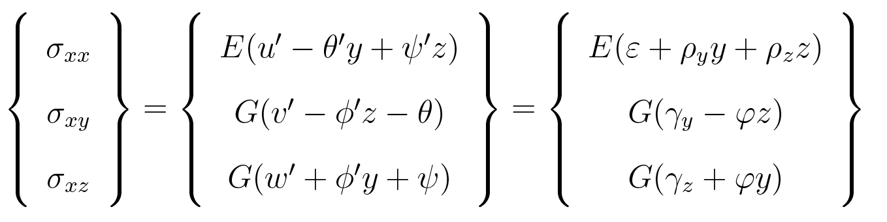
Development of a finite element model for rotordynamics

Slide 19
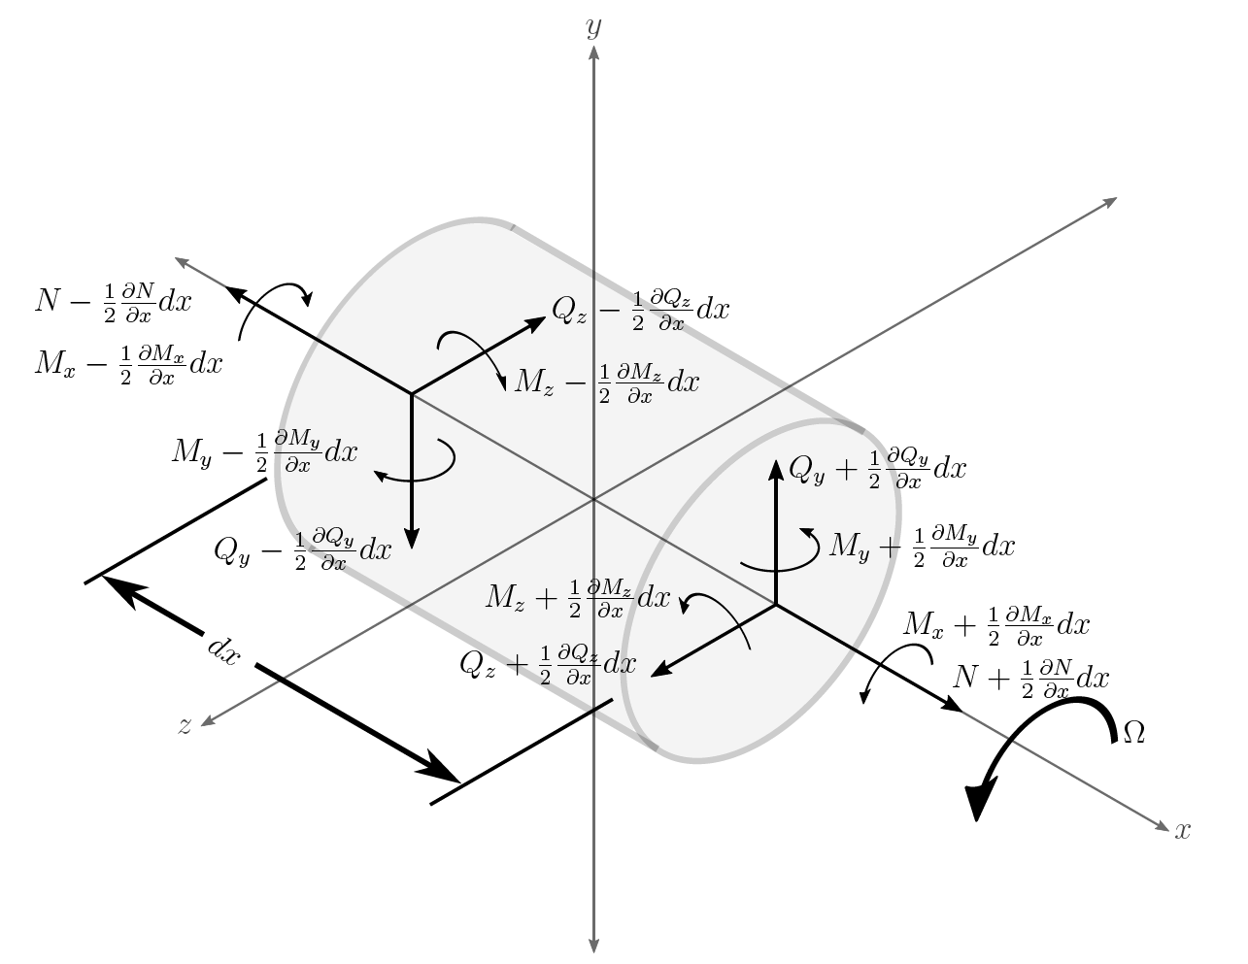
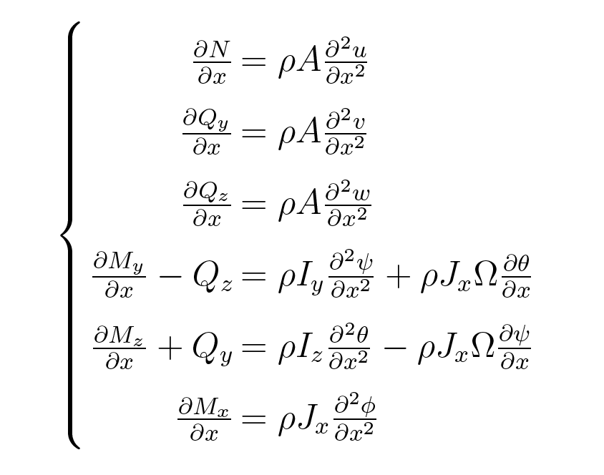
Development of a finite element model for rotordynamics

Slide 20
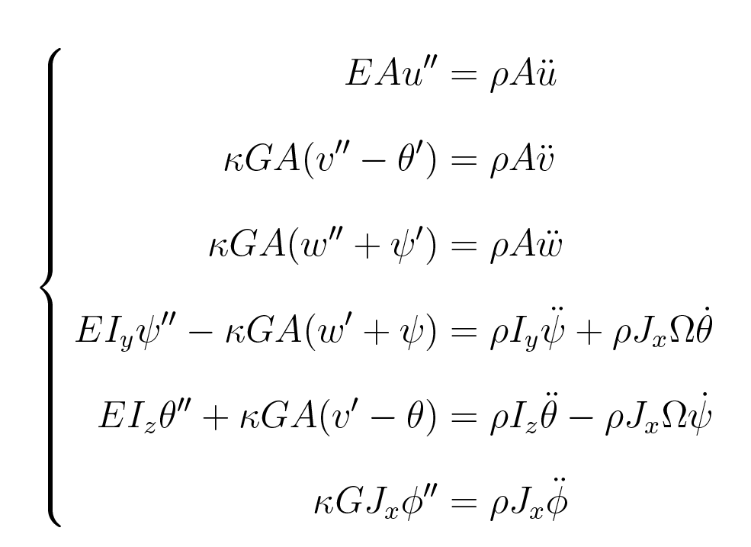
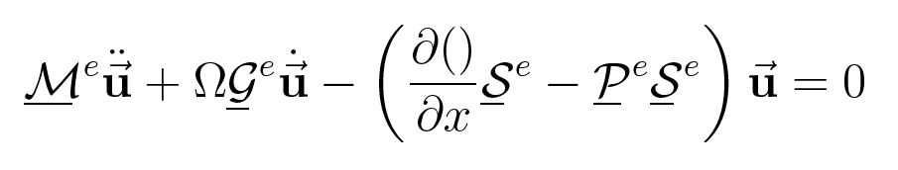
Development of a finite element model for rotordynamics

Slide 21
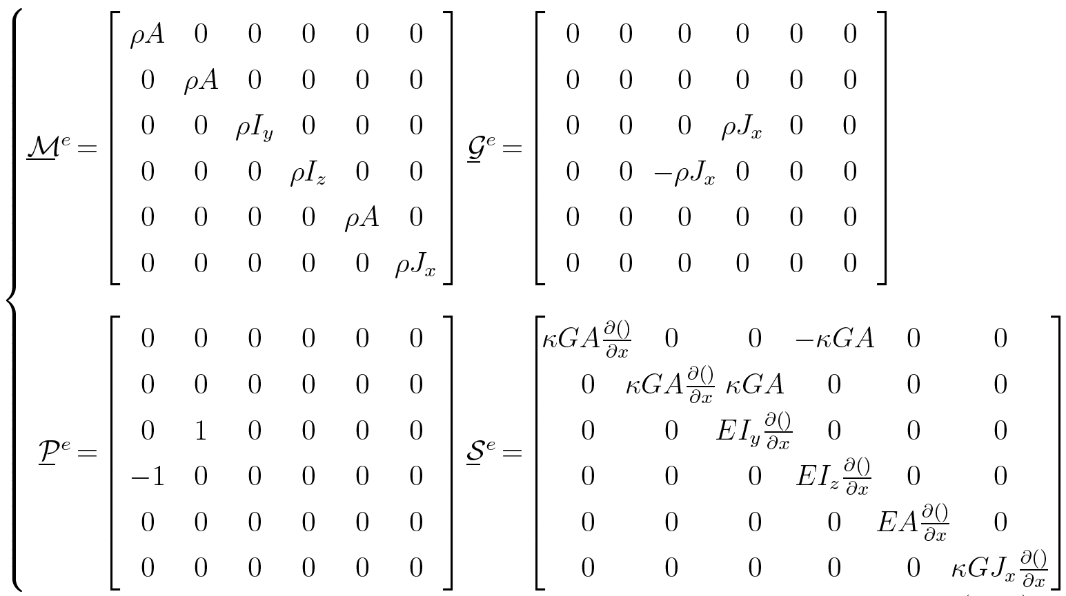
Development of a finite element model for rotordynamics

Slide 22
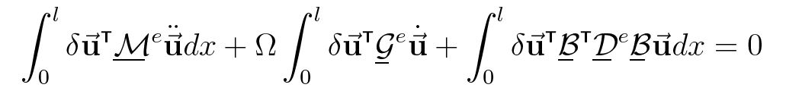
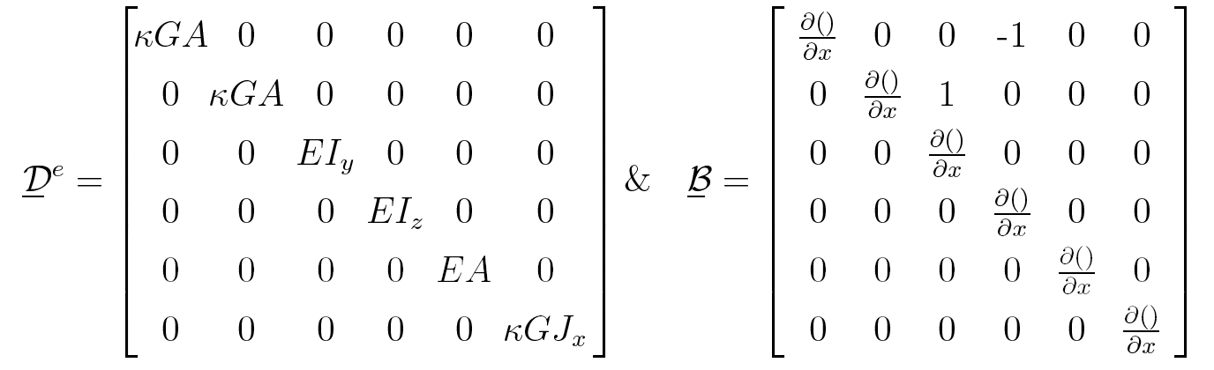
Development of a finite element model for rotordynamics

Slide 23
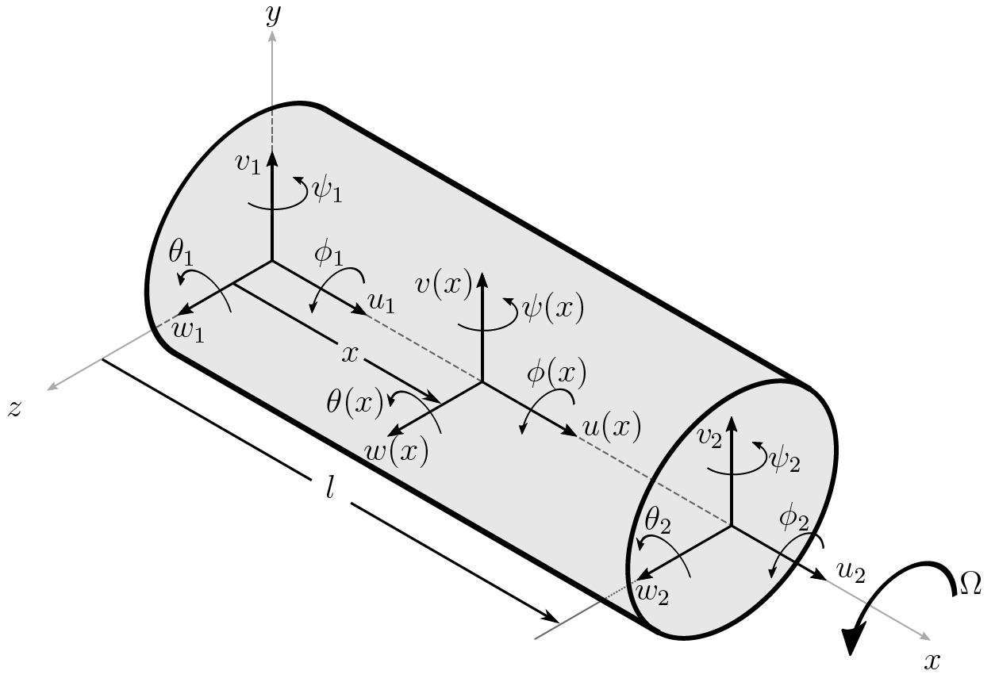
Development of a finite element model for rotordynamics

Slide 24
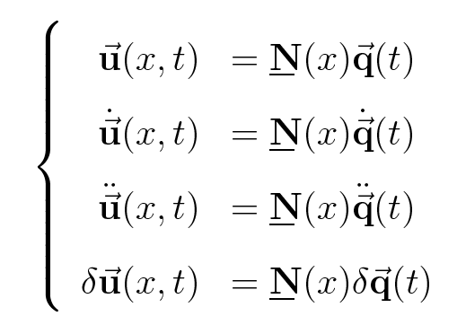
Development of a finite element model for rotordynamics

Slide 25
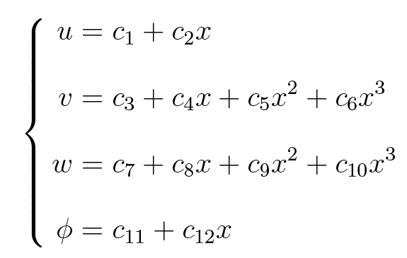


Development of a finite element model for rotordynamics

Slide 26

Development of a finite element model for rotordynamics

Slide 27


Development of a finite element model for rotordynamics

Slide 28

Development of a finite element model for rotordynamics

Slide 29

Development of a finite element model for rotordynamics

Slide 30




Development of a finite element model for rotordynamics

Slide 31



Development of a finite element model for rotordynamics

Slide 32


Development of a finite element model for rotordynamics

Slide 33


Development of a finite element model for rotordynamics

Slide 34







Development of a finite element model for rotordynamics

Slide 35




Development of a finite element model for rotordynamics

Slide 36



Frequency domain processing of rotordynamic models
Eigenvalue and eigenvector analysis
Roots Locus
Campbell
Mode Shapes
Bode diagram
Nyquist Diagram
Frequency Response

Slide 37




Frequency domain processing of rotordynamic models
Eigenvalue Problem:

Slide 38


Frequency domain processing of rotordynamic models
Synchronous Frequency Response Function:

Slide 39


Frequency domain processing of rotordynamic models

Slide 40



Frequency domain processing of rotordynamic models

Slide 41


Frequency domain processing of rotordynamic models

Slide 42


Frequency domain processing of rotordynamic models

Slide 43



Comparison of experimental and model analyses

Slide 44

Comparison of experimental and model analyses

Slide 45

Comparison of experimental and model analyses

Slide 46

Comparison of experimental and model analyses

Slide 47


Comparison of experimental and model analyses

Slide 48


Comparison of experimental and model analyses

Slide 49


Comparison of experimental and model analyses

Slide 50

Comparison of experimental and model analyses

Slide 51


Comparison of experimental and model analyses

Slide 52









Comparison of experimental and model analyses

Slide 53

Comparison of experimental and model analyses

Slide 54

Comparison of experimental and model analyses

Slide 55

Comparison of experimental and model analyses

Slide 56


Comparison of experimental and model analyses
AMB at node 7
Complete levitation with AMB replacing bearing at node 4

Slide 57
Future Work
Possible future projects based on the continuation of this work will
further investigate AMB model, and implement an actual experiment on overhung rotor.
extention of this finite element model to include non linear terms.
extention of this finite element model to include more detailed disk models for the analysis of turbomachines.
extention of this finite element model to include rotating damping effects from various fittings, couplings and seals.

Slide 58
Questions?

